Slide 1
CS-4031 Compiler Construction Chapter 4 cont.
Faryal Saud
Lecturer, Department of Computer Science
FAST NUCES CFD

Slide 2
Bottom Up Parser
Bottom-up parsing is a type of syntax analysis method where the parser from input symbols(tokens) and attempts to reduce them to start symbol of grammar (S).
Basic Components
Start with tokens
Shift and reduce

Slide 3
Components
Start with tokens
The Parser begins with the terminal symbols (the input tokens), which are the leaves of the parse tree.
Shift
The next token pushed onto a stack.
Reduce
A sequence of symbols on the stack is replaced by a non-terminal according to the production rules of grammar.

Slide 4
Example
E → T
E → T * F
T → id
F → T
F → id
Input string = id * id

Slide 5
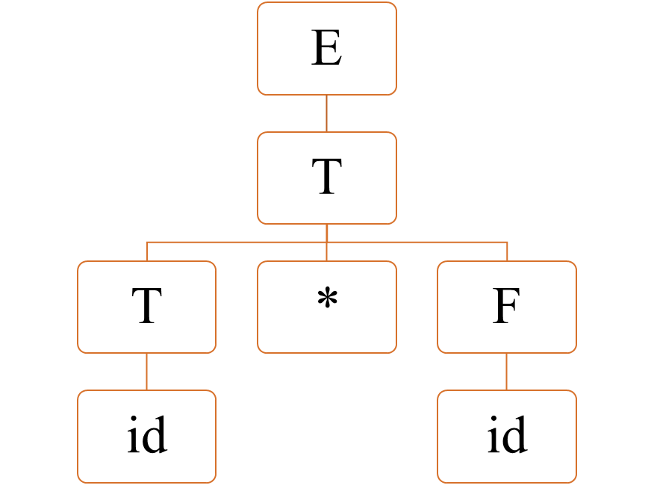
Input id * id

Slide 6
Input id * id
id * id
Id * id | F * id id | T * id F id | T * F F id id | T T * F F id id | E T T * F F id id

Slide 7
Bottoms up Parser
Bottom-Up Parser
LR Parser
Operator Precedence Operator
LR(0)
SLR(1)
LALR(1)
CLR(1)

Slide 8
LR Parser
LR Parser
LR(0)
SLR(1)
LALR(1)
CLR(1)

Slide 9
LR Parser
LR parsing is a type of bottom-up parsing technique used to handle large and complex grammars.
LR Means
L stands for left-to-right scanning of the input. It means the parser reads the input string one symbol at a time from left to right.
R stands for right most derivation in reverse.

Slide 10
LR(0) Parser
Augmented Grammar
If P is a grammar with started symbol S, then G` augmented is new augmented grammar with the starting symbol S` and new production will be S` → .S.

Slide 11
LR(0) Parser
In this we used LR(0) canonical item
In LR(0) grammar, we do the following steps
Augment the given grammar

Slide 12
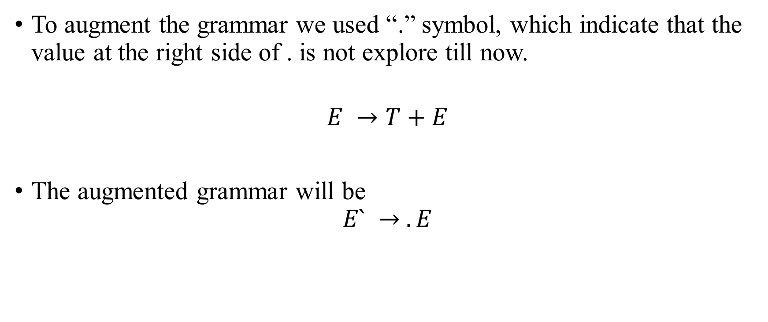
LR(0) Parser : Augmented Grammar
To augment the grammar we used “.” symbol, which indicate that the value at the right side of . is not explore till now.
$$E →T+E$$
The augmented grammar will be
$$E` → .E$$

Slide 13

LR(0) Parser
$E →T+E$ | T
$T→id$
Augmented Grammar
$E` → .E$
$E →. T+E$
$E → .T$
$T → .id$

Slide 14





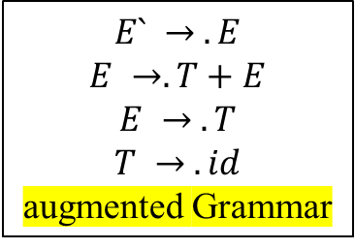
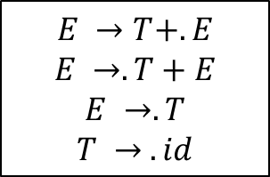



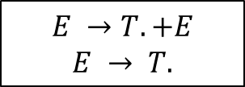

LR(0) Parser
$$I_{5}$$
$$E →T+E.$$
$$E` → E.$$
$$I_{1}$$
$$I_{0}$$
E
E
$$E` → .E$$
$$E →. T+E$$
$$E → .T$$
$$T → .id$$
augmented Grammar
$$I_{2}$$
$$I_{4}$$
T
$$E →T.+E$$
$$E → T.$$
+
$$E →T+. E$$
$$E →.T+E$$
$$E →.T$$
$$T → .id$$
id
T
$$I_{3}$$
$$T → id.$$
id

Slide 15
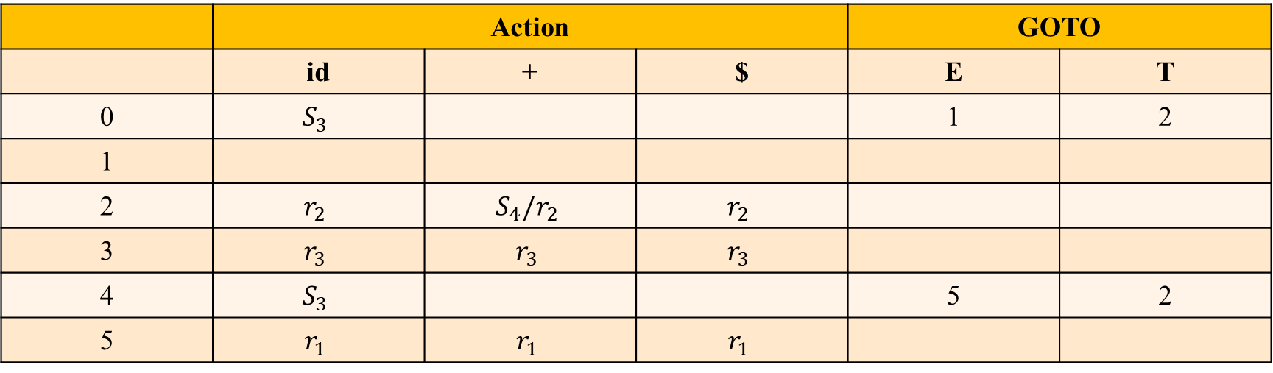
LR(0) Parsing Table
 | Action |  |  | GOTO
 | id | + | $ | E | T
0 | $$S_{3}$$ |  |  | 1 | 2
1
2 | $$r_{2}$$ | $$S_{4}/r_{2}$$ | $$r_{2}$$
3 | $$r_{3}$$ | $$r_{3}$$ | $$r_{3}$$
4 | $$S_{3}$$ |  |  | 5 | 2
5 | $$r_{1}$$ | $$r_{1}$$ | $$r_{1}$$

Slide 16

LR(0) Parser: Example 2
$S →(L)$
$S→a$
$L →S$
$L →L,S$

Slide 17
Augmented Grammar
S” → .S
S → .(L)
S → .a
L → .S
L → .L, S

Slide 18
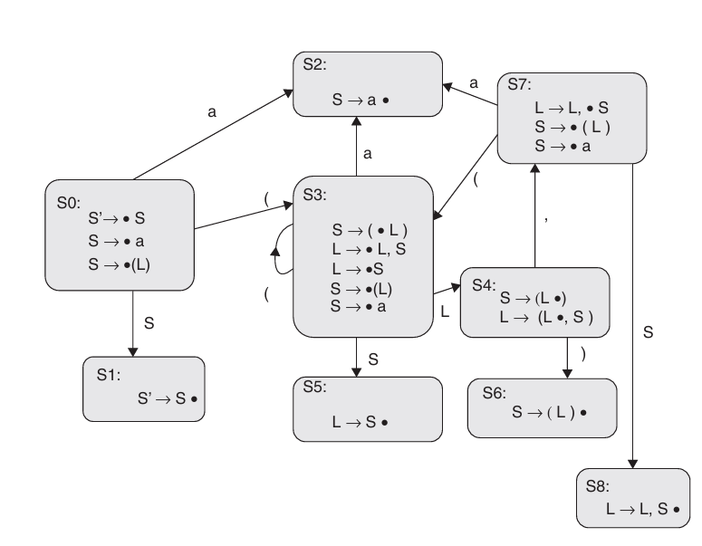
LR(0) Parsing Table

Slide 19
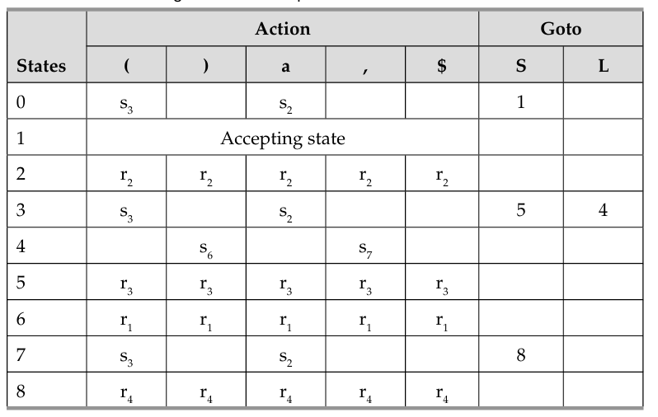
LR(0) Parsing Table

Slide 20

LR(0) Parser :
$E →BB$
$B→cB | d$
Augmented Grammar
$E` → .E$
$E →. BB$
$B → .cB$
$B → .d$

Slide 21
String : ccdd$
$E →BB$
$B→cB | d$
Augmented Grammar
$E` → .E$
$E →. BB$
$B → .cB$
$B → .d$

Slide 22




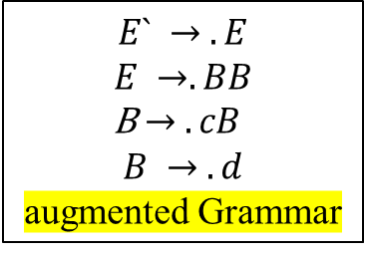



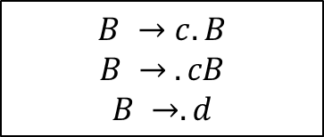


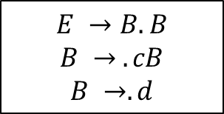


String : Diagram$
$$E` → E.$$
$$I_{1}$$
$$I_{0}$$
E
$$E` → .E$$
$$E →. BB$$
B$→ .cB$
$$B → .d$$
augmented Grammar
$$I_{2}$$
$$I_{5}$$
B
$$E →B.B$$
$$B → .cB$$
$$B →.d$$
B
$$E →BB.$$
c
c
d
$$I_{3}$$
d
$$I_{6}$$
$$I_{4}$$
$$B →c. B$$
$$B → .cB$$
$$B →.d$$
B
$$B →cB.$$
$$B →d.$$
d
c

Slide 23
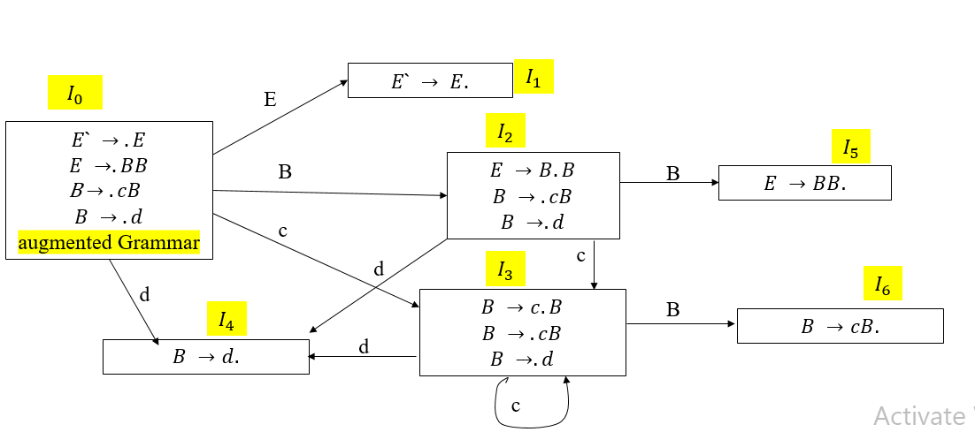
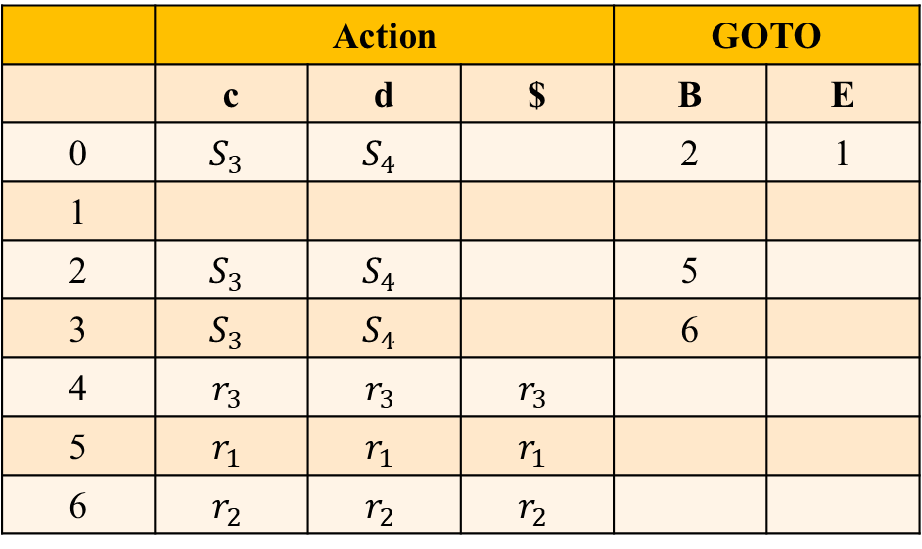
String Traversal : ccdd$
 | Action |  |  | GOTO
 | c | d | $ | B | E
0 | $$S_{3}$$ | $$S_{4}$$ |  | 2 | 1
1
2 | $$S_{3}$$ | $$S_{4}$$ |  | 5
3 | $$S_{3}$$ | $$S_{4}$$ |  | 6
4 | $$r_{3}$$ | $$r_{3}$$ | $$r_{3}$$
5 | $$r_{1}$$ | $$r_{1}$$ | $$r_{1}$$
6 | $$r_{2}$$ | $$r_{2}$$ | $$r_{2}$$

Slide 24
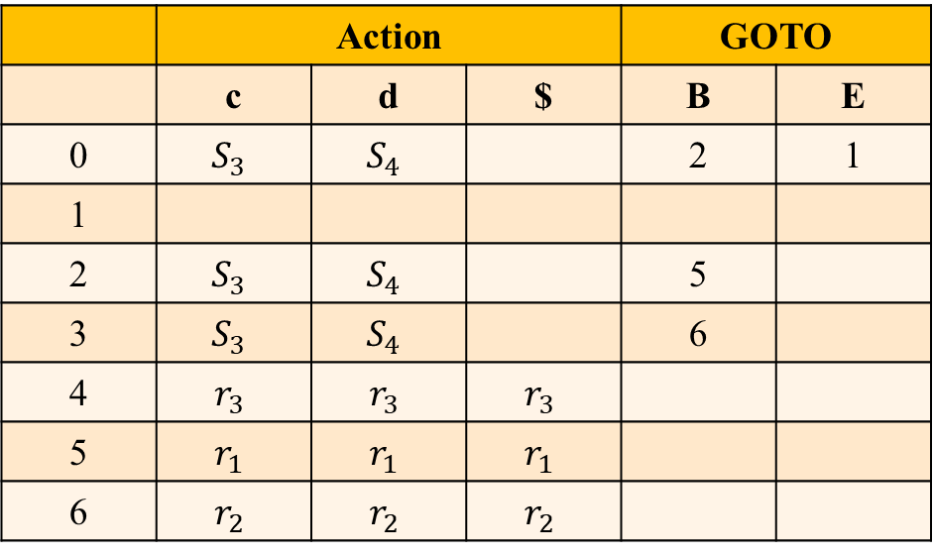
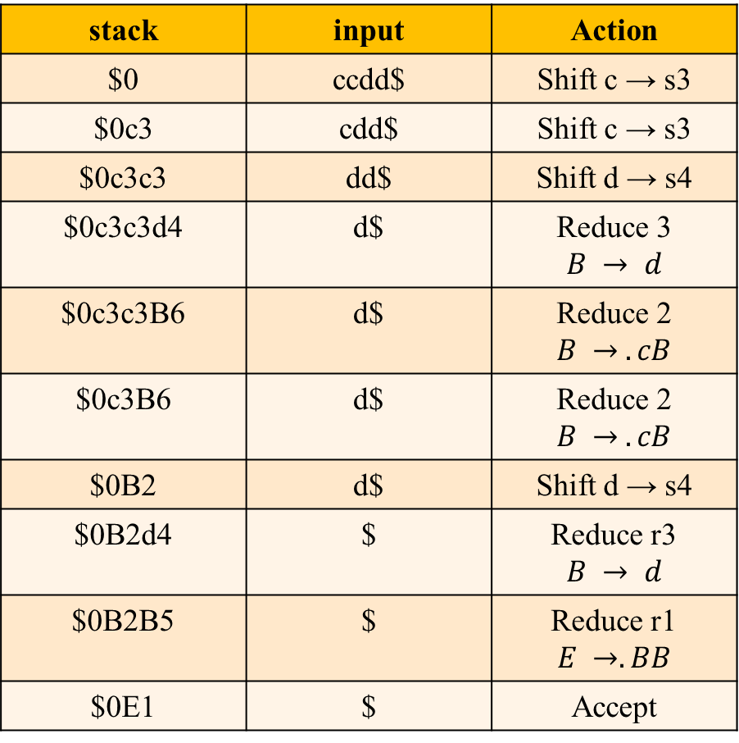

String Traversal : ccdd$
$$E` → .E$$
$$E →. BB$$
$$B → .cB$$
$$B → .d$$
stack | input | Action
$0 | ccdd$ | Shift c → s3
$0c3 | cdd$ | Shift c → s3
$0c3c3 | dd$ | Shift d → s4
$0c3c3d4 | d$ | Reduce 3 $$B → d$$
$0c3c3B6 | d$ | Reduce 2 $$B → .cB$$
$0c3B6 | d$ | Reduce 2 $$B → .cB$$
$0B2 | d$ | Shift d → s4
$0B2d4 | $ | Reduce r3 $$B → d$$
$0B2B5 | $ | Reduce r1 $$E →. BB$$
$0E1 | $ | Accept
 | Action |  |  | GOTO
 | c | d | $ | B | E
0 | $$S_{3}$$ | $$S_{4}$$ |  | 2 | 1
1
2 | $$S_{3}$$ | $$S_{4}$$ |  | 5
3 | $$S_{3}$$ | $$S_{4}$$ |  | 6
4 | $$r_{3}$$ | $$r_{3}$$ | $$r_{3}$$
5 | $$r_{1}$$ | $$r_{1}$$ | $$r_{1}$$
6 | $$r_{2}$$ | $$r_{2}$$ | $$r_{2}$$

Slide 25
Advantages of LR(0) Parser
It is very simple to construct the LR(0) Parser compared to other LR parsers.
Each row in the table defines unique action, that is, either shift action or reduce action or accept.

Slide 26
Disadvantages of LR(0) Parser
The LR(0) Parser can be used to parse a small class of grammars.
Look ahead is not used in making parsing decisions

